Slide 1
Market Identifier
Ryan Ticlo (ticlor)
Kenny Kim (kimm54)
Rickesh Mistry (mistrrp)
Muyideen Jimoh (jimohma)

Slide 2
Table of Contents
Team Members
Introduction
Motivation
Walkthrough Scenario
Components
Survey
Limitations
Acknowledgements

Slide 3
Team Members
Ryan Ticlor
Kenny Kim
Rickesh Mistry
Business Informatics Program
Worked in BI&A team (IT Developer)
Muyideen Jimoh

Slide 4
Introduction
Market Identifier solution is a business analytics application that helps small businesses and new entrepreneurs identify profitable niche opportunities.
allows new entrepreneurs to strategically penetrate markets with low budgets
queries Amazon, eBay, and Walmart to find sales data from major competitors
calculates a MI Score based on several factors to determine markets success probability
Notes:
What is the solution?
Who is the user?

Slide 5
Motivation
Entrepreneurs can compete with larger businesses by operating in niche markets
The lower demand in niche markets make it not as desirable for larger businesses
Niche markets may have sufficient demand for individual entrepreneurs
Market analysis allows people to better identify profitable gaps to capitalize on
By helping small businesses identify niche markets we can:
provide a new stream of income to entrepreneurs
Provide a better selection of goods to consumers
Notes:
We wanted to create a solution/business that we could operate after graduating

Slide 6
Comparison to Other Products
The competitor products, JungleScout and Helium10, only provide an analysis on sales data for Amazon
Our solution provides detailed sales data and competitor activity from three e-commerce platforms:
Amazon
eBay
Walmart.
Our solution helps gage the success probability of the market by analyzing several factors such as:
Sales
Rating
Brand dominance
Reviews

Slide 7
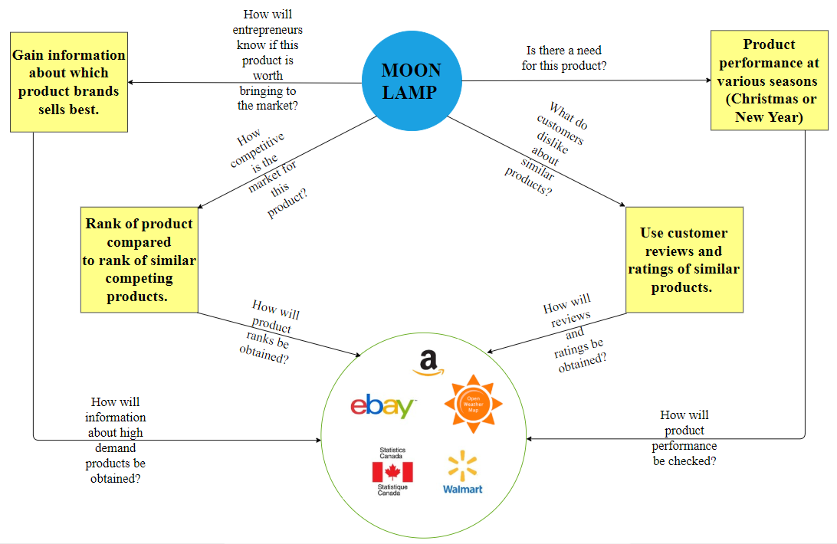
Walkthrough Scenario

Slide 8
Components

Slide 9
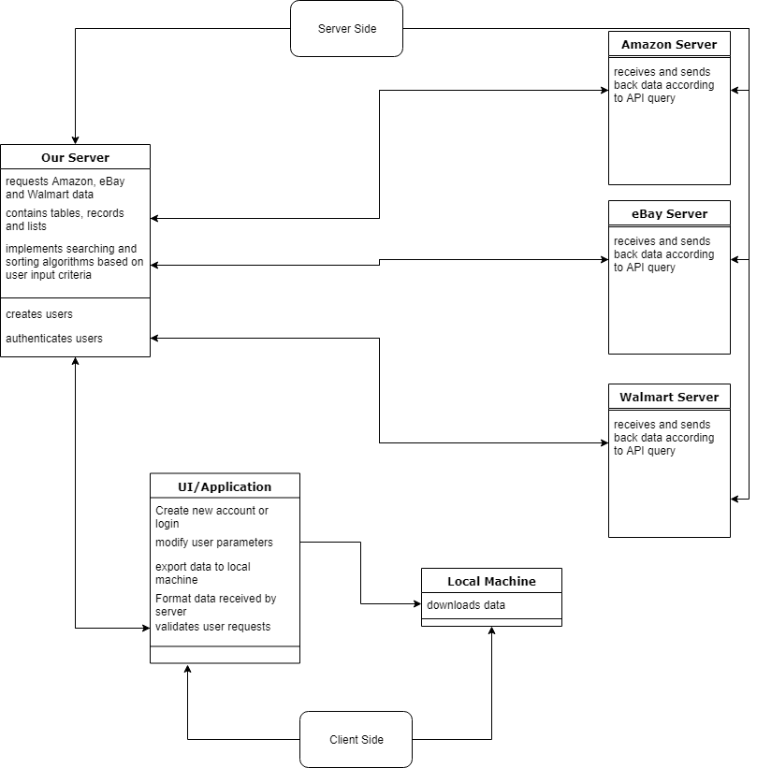
Overview
Users access the solution through a web application
AWS hosts solution and authenticates user
Queries are made through Keepa (Amazon), Ebay, and Walmart API’s to retrieve data from external systems
Server side algorithms process data and calculate MIScore

Slide 10
APIScript and ModifyData

Slide 11
CriteriaFilter

Slide 12
MIScore

Slide 13
AWS

Slide 14
Website

Slide 15
Survey

Slide 16
Limitations
Query limit

Slide 17
Acknowledgements

Slide 18
Thank you!

